Slide 1
ECCDH3DES
Nico Bellante, Lucas Dahl, Manish Gupta, Xiong-Yao Zha

Slide 2
Overview
We designed a chip used for secure encryption of data.
Intended function/use
Our design is very secure
Our design is much faster in an ASIC implementation

Slide 3
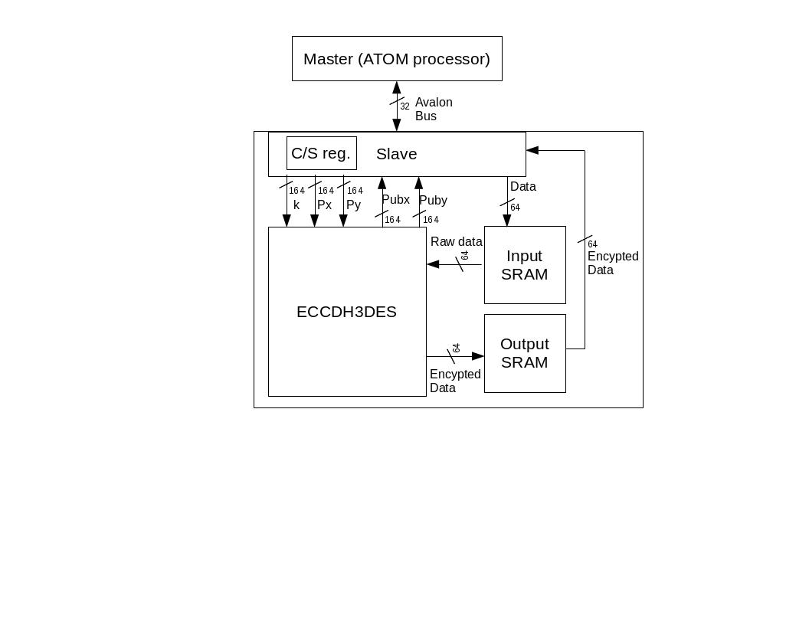
System Design on FPGA

Slide 4
System Operations
Upon reset generate our Public key using ECC of our Private key
Then we generate a session key using ECC of our Private key and a given Public key
Finally we encrypt data using Triple DES encryption with our created session key

Slide 5
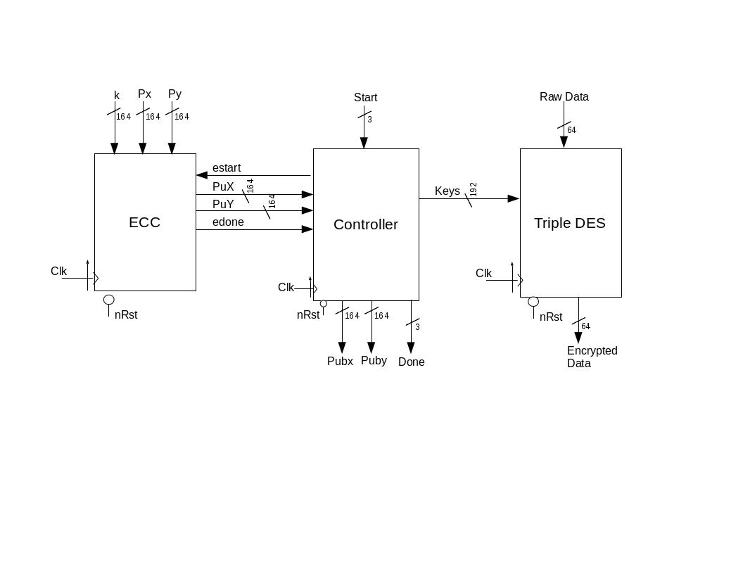
Top Level Diagram

Slide 6
System Design
We chose to optimize the area of our ECC module.
35.5 mm^2 cut down to 15.7 mm^2
Why?
We chose to pipeline our DES so we could have encrypted data coming out every clock cycle.

Slide 7
Improvements we've made
We chose to optimize the area of our ECC

Slide 8
Design Specific Success Criteria
Demonstrate by simulation of a Verilog test bench:
That the public keys of A that are generated are correct.
That the values of Skx and Sky are both generated correctly.
That given a key, the Triple DES encryption gives the the correct output values.
That the controller module correctly transitions through its states.

Slide 9
Layout
Indicate design dimensions, layout critical path delay, synthesis critical path delay, and timing budget estimated critical path delay

Slide 10
Layout
Indicate design dimensions, layout critical path delay, synthesis critical path delay, and timing budget estimated critical path delay

Slide 11
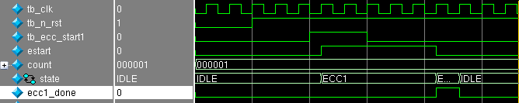
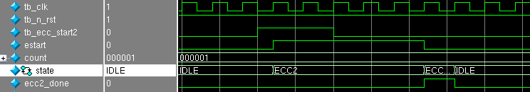
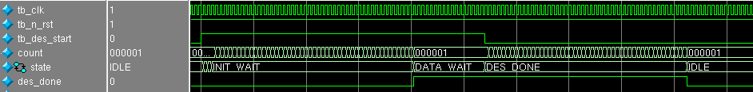


Controller Test Results
Coming off reset do ECC
Describe more
Change name

Slide 12
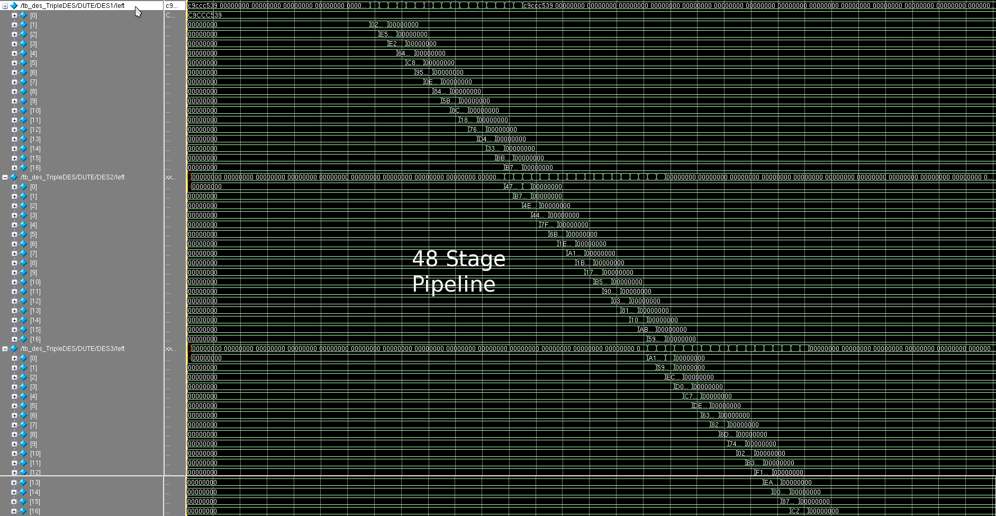
Triple DES Test Results

Slide 13
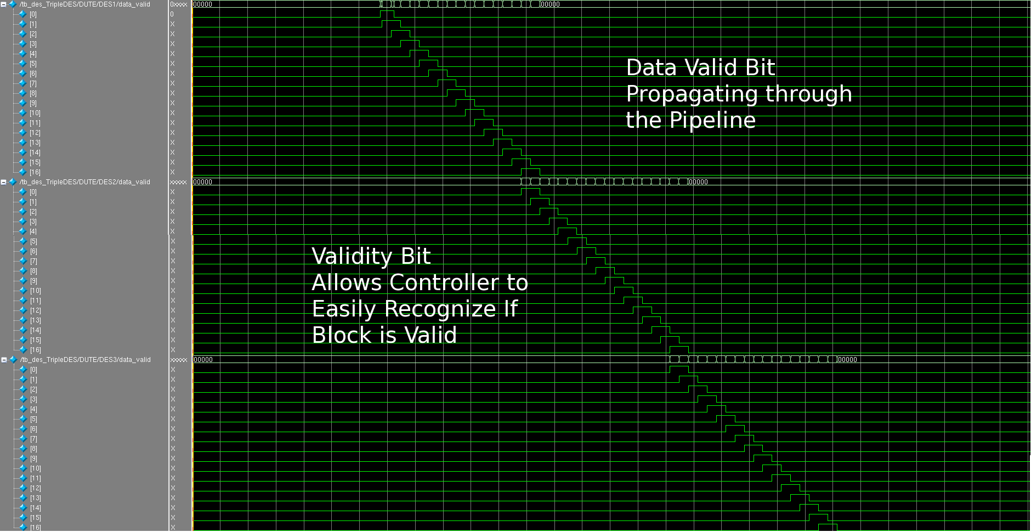
Triple DES Test Results

Slide 14
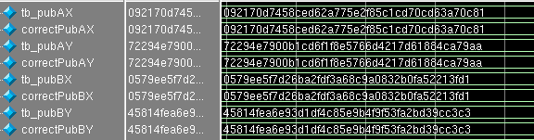
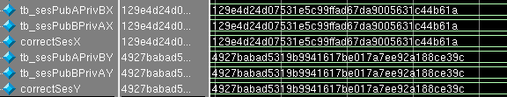
ECC Test Results
Generated Session Keys
Generated Session Keys

Slide 15
Conclusions
Challenges we faced:
Implementing the ECC algorithms
Debugging and optimizing ECC
FPGA implementation
If we were to do this project again we would research alternate algorithms for ECC
If we had more time we would have used a more generic bus protocol in our design.

Slide 16
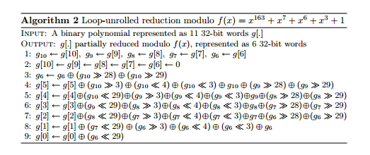
Diagrams for Reference
GF_mod:

Slide 17
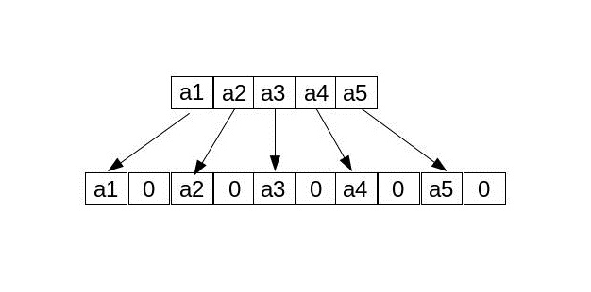
Diagrams for Reference
GF_square

Slide 18
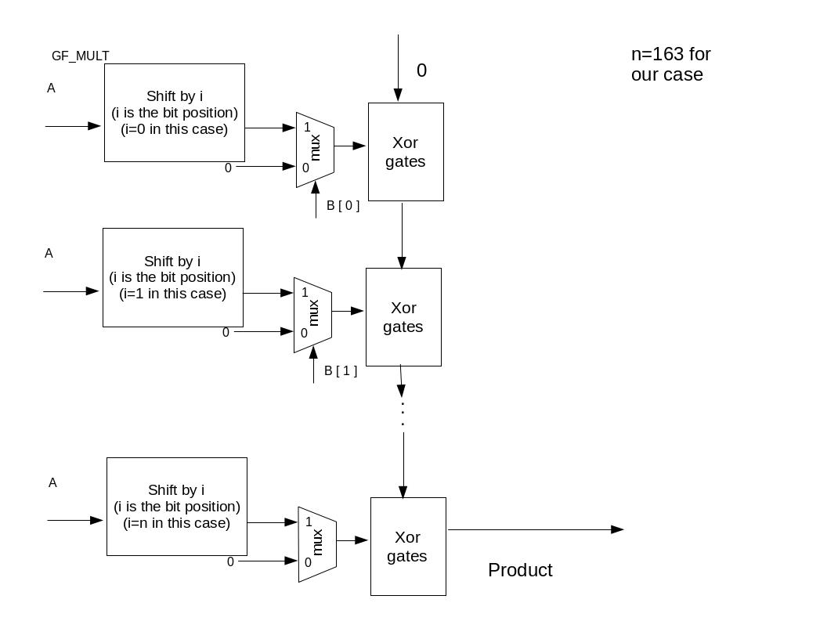
Diagrams for Reference
GF_mult

Slide 19
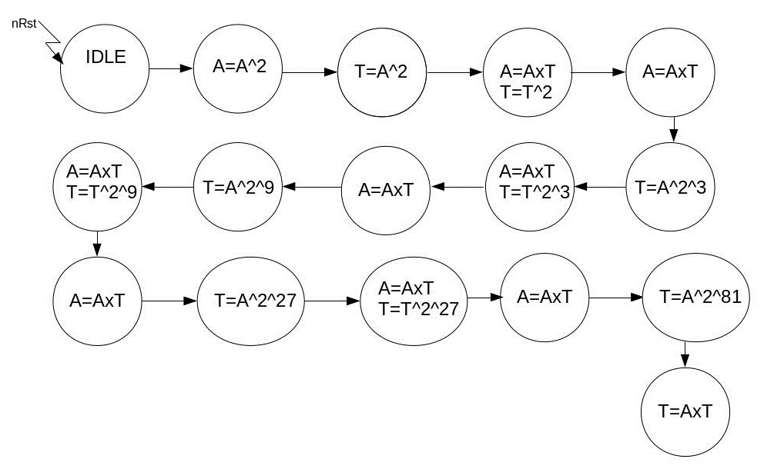
Diagrams for Reference
GF_divide

Slide 20
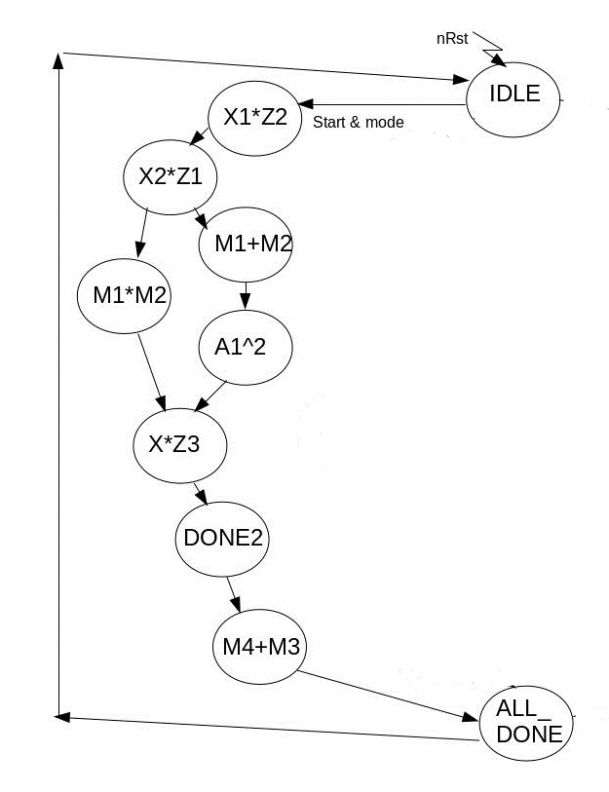
Diagrams for Reference
Point Additon

Slide 21
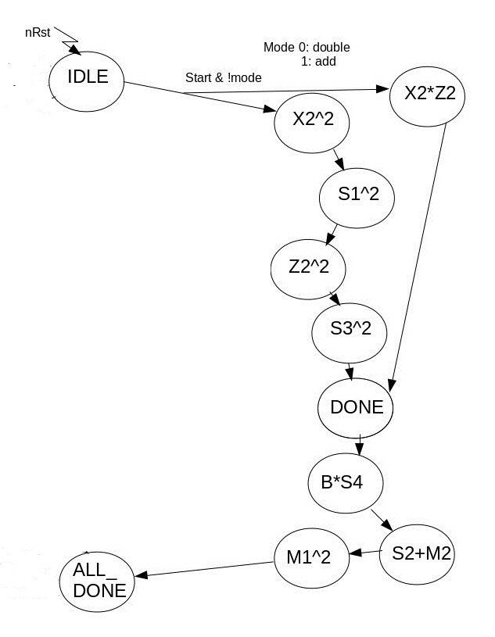
Diagrams for Reference
Point Double

Slide 22
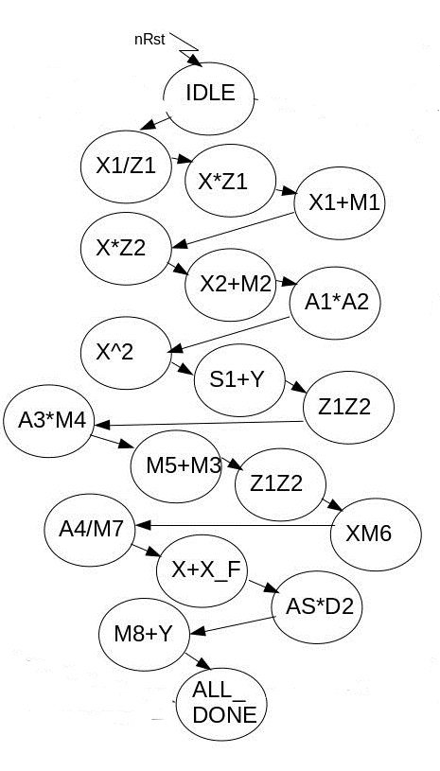
Diagrams for Reference
Mxy

Slide 23
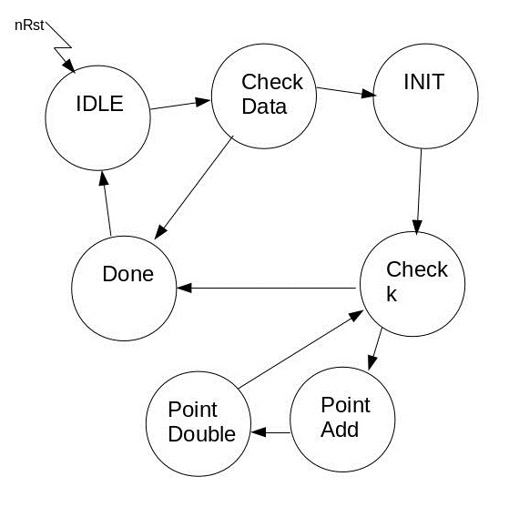
Diagrams for Reference
Point Multiplication

Slide 24
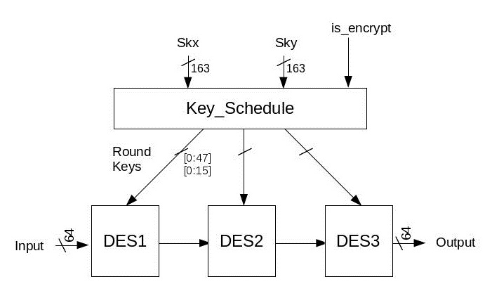
Diagrams for Reference
Triple DES

Slide 25
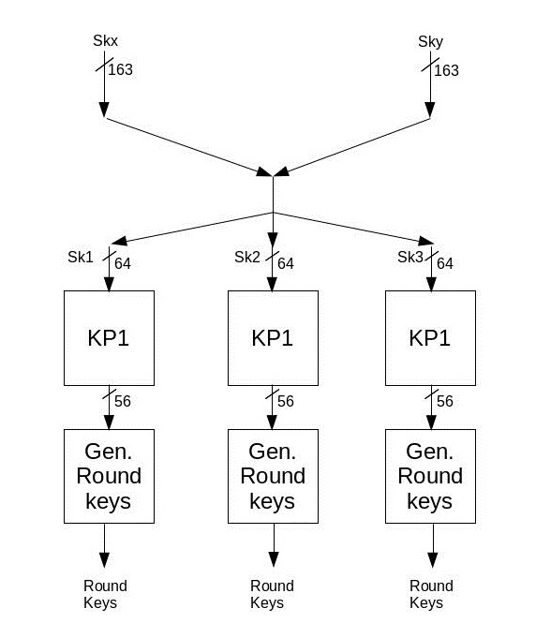
Diagrams for Reference
Key Schedule

Slide 26
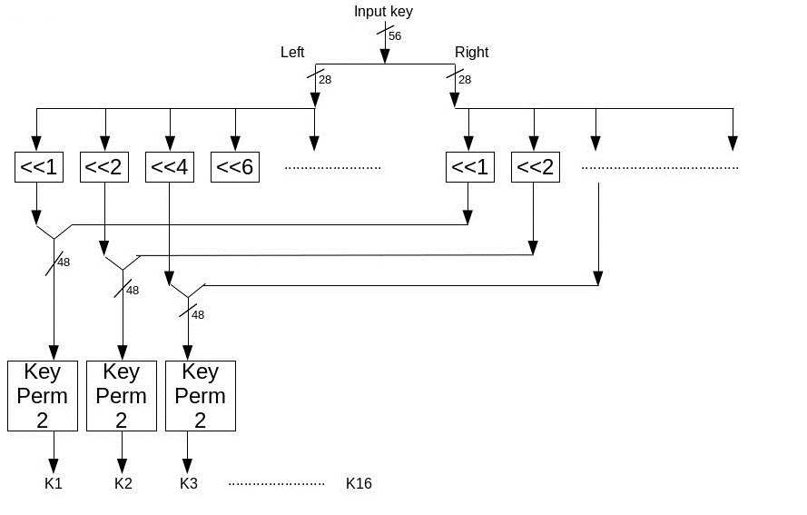
Diagrams for Reference
Generate Round Keys

Slide 27
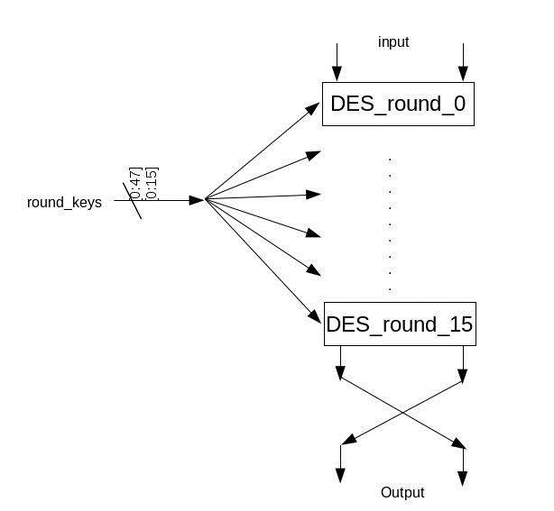
Diagrams for Reference
DES

Slide 28
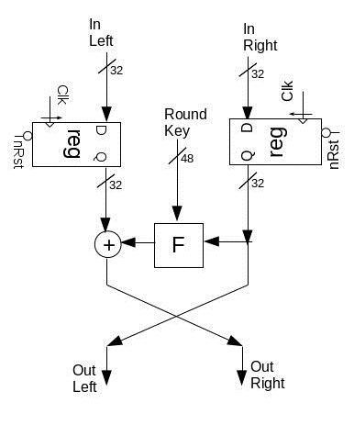
Diagrams for Reference
DES_Round

Slide 29
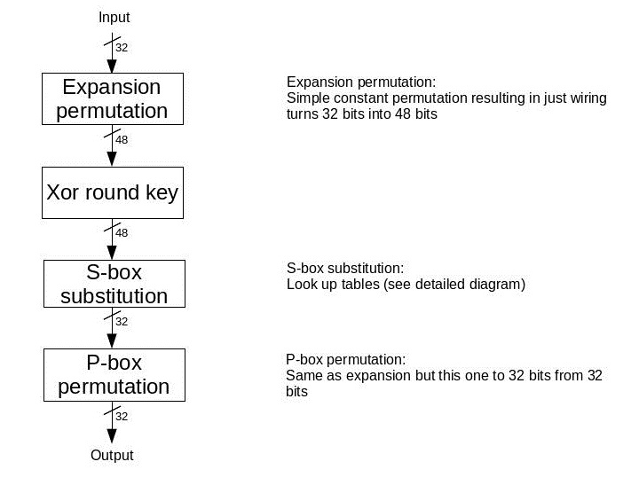
Diagrams for Reference
Feistel

Slide 30
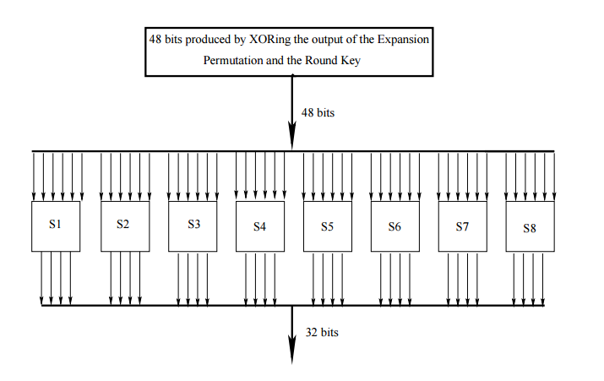
Diagrams for Reference
S-Box Substitution

Slide 31
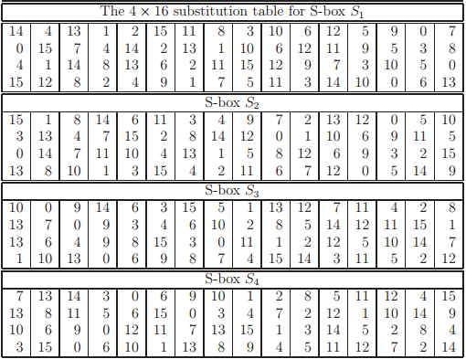
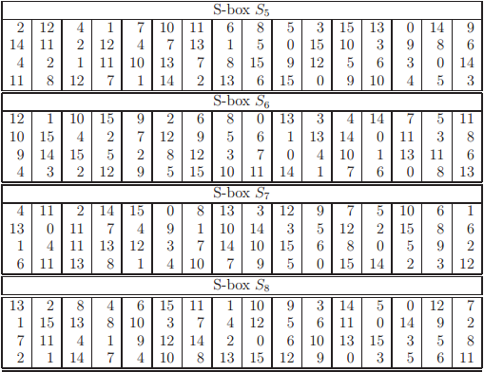
Diagrams for Reference
S-Box Substitution

